Slide 1
Kanban vs. SCRUM Links
By Joel Robinson February 2011
Links to memorize:
www.kanban101.com
http://www.limitedwipsociety.org
Free eBook Kanban vs. Scrum
http://www.crisp.se/henrik.kniberg/Kanban-vs-Scrum.pdf
http://www.infoq.com/minibooks/kanban-scrum-minibook
.
.

Slide 2
Kanban means limiting WIP Work In Progress
Kanban is Japanese, means visual card or signboard or billboard.
Kanban originated at Toyota and was applied to limiting inventory.
Every product (major components like cars) had a card stuck on a bulletin board tracking where it was.
New cards came in as new components arrived and old cards left the bulletin board as components left the factory.
Goals:
Keep # cars in the plant at a minimum
Keep all cars moving, no bottlenecks
Know where each car is at any moment in time

Slide 3
Currency
It does not matter what the currency is, you can buy and sell anywhere in the world.
Problems “car components” have in common with SW development and test:
Time constraints -- Deadlines
Bottlenecks -- Inspections
Re-work/rejections --different sizes
New projects compete with finishing old projects

Slide 4
SCRUM uses calendar work cycles
SCRUM cycles are calendar based.
Projects are estimated and broken into separate tasks prior to cycle
Teams take on “x” # tasks for an iteration
Tasks are worked on start to finish in a cycle.
Tasks are finished when the estimated work is done.
Completed tasks are passed on to next group without consideration of their workloads
Swarms are the exception, when a team drops what they are doing to help a bottleneck elsewhere

Slide 5
Inside a SCRUM iteration there are two waterfalls… QA and Development
Development
Testing
Developers start early
Development continues till code complete
Developers may or may not do build testing
Modifications continue while testing
Developers pull new projects, get reassigned
Bug fixes handed to QA for deployment and installation
QA starts later
QA may be finishing task from last iteration
QA gets project at code complete
After hand-off developers support diminishes
QA handles deployment, installation, and support problems
Bug fixes involve regression testing

Slide 6
http://www.kanban101.com/what-is-kanban/
What is Kanban?
Kanban is a lean agile system that can be used to enhance any software development lifecycle including Scrum, XP, or Waterfall. It is NOT EXCLUSIVE.
Its goal is the efficient delivery of finished tasks
Kanban promotes the lean concept of flow
to continuously and predictably deliver value.
The work and the workflow is made visible
to make activities and issues like backups obvious.
Kanban limits work in progress to promote focus and finishing, and indirectly, quality

Slide 7
Scrum vs. Kanban?
SCRUM:
Split calendar into fixed cycles or sprints
Split organization into small self organizing teams
Split work into deliverables
Estimate size & priority
Initiate tasks based on priority and resources
Limit Work in Progress to sprint tasks
Optimize # tasks
Optimize via retrospectives
Integrate to release at end
Kanban:
Visualize workflow and teams
Split organization into small self organizing teams
Split work into deliverables
Assign tasks a priority
Initiate tasks based on priority
Limit Work in Progress for each team
Optimize cycle time
Optimize via retrospectives
Integrate continually

Slide 8
Work Process Flow Responsibilities
Backlog
Decide what to do
Sales, Future Product management, business team
Analysis
Specification and acceptance criteria
Product Owners
Development
Develop the code
Engineering Team
Test
Test the code
QA Team
Merge and Deploy
Configuration and deploy (release) the code to consumer

Slide 9
Why limit the WIP?
Limiting WIP Rules:
Product cycle time is how long it takes a work item to flow to completion.
Limiting WIP will reduce overall cycle time.
The chosen work is always the highest priority of any group.
Queues start backing up immediately at any blockage.
A blockage anywhere slows down the entire system
Blockages are resolved by reallocating resources to fix the problem
Limiting WIP reduces complexity of tasks (less switching)
Limiting WIP reduces lead times and increases quality
Quality is increased due to earlier addressing of issues
David Joyce on what happens when blocks occur in a limited workflow

Slide 10
Tasks Lifecycle
Business analyst requests new feature
Project manager/ Biz manager assign priority
Product Owner gets requirements & acceptance criteria
Development team pulls highest priority task when slot opens
Developers (sub-teams) work on WIP tasks
Development >> QA
QA >> Merge & Deploy
Engineering swarms to resolve bottlenecks
As Tasks near completion Product Owners ready next task for entry

Slide 11
What do you mean “Flow?”
Work is processed in small chunks
Teams limited to a few items in progress
Work items have defined conditions of acceptance
Work items have priority
Work items have specifications or sources of information to begin work
Teams do less context-switching
Team members work on 1-2 tasks at a time

Slide 12
Kanban Game Board Layout
BUSINESS & ANALYSIS TEAM |  | DEVELOPMENT TEAM |  |  | TEST TEAM |  | MERGE AND DEPLOY TEAM
WIP FEATURES& RELEASE BUGS | PLANNED PILE | WIP DEV PILE | WIP BUGS PILE | CODED PILE | WIP TEST PILE | PASSED PILE | WIP MERGE PILE | DONE PILE

Slide 13
DEFINITIONS
BACKLOG Features, special projects, bugs
Production Bugs Not from WIP
WIP DEFINE Stories and bugs being defined and analyzed
PLANNED Developer ready, with priority, specifications, COA
DEVELOPMENT Programmers, architects, coders, builders
WIP TASKS Features under Development
WIP BUGS WIP bugs from QA or Merge
CODED Queue for testers to pull from
TESTING Testers and test architect resources
WIP TEST features and bugs under test
PASSED QA has completed testing of task or bug fix
MERGE-DEPLOY Put code into next production release
WIP Merge Merge and deploy to consumer
DONE Task released to production, out of factory

Slide 14
Rules for Business & Analysis Team
Create feature / Release Bug name and label with 2-3 random words
Example “Joel’s Killer App” or “DB Performance Issue”
Write on feature sheet
Log time of day feature was ‘born’
Roll dice 4 times and Sum total = # hours
Write # hours on feature sheet
Roll dice for priority (high=12)
Write priority on feature sheet
When feature sheet is filled put on Planned pile sort by priority, highest on top

Slide 15
Rules for Development team
Pull a task from Planned or WIP Bug pile if you have capacity -- Team Capacity = # players x 2
Lay WIP features and bugs out before the team
Each team member chooses 1-2 tasks to work on for this roll
Each team member rolls one dice when called
If the team rolls a pair, place a “BUG” sheet on development team’s WIP Bugs pile (Bug=6 hours)
Subtract your die # from your sheets (you may split)
When a feature or bug hours are counted down put sheet on “CODED” pile

Slide 16
Rules for Test Team
Pull feature/bug from Coded pile if you have capacity -- Team Capacity = # players x 2
Lay WIP features and bugs out before the team
Each team member chooses 1-2 tasks to work on for this roll
Each team member rolls one dice when called
If the team rolls a pair, place a “BUG” sheet on development team’s WIP Bugs pile (Bug=6 hours)
Subtract your die # from your sheets (you may split)
When a feature or bug hours are counted down put sheet on “PASSED” pile

Slide 17
Rules for Merge/Deploy Team
Pull feature/bug from “Passed” pile if you have capacity -- Team Capacity = # players x 2
Lay WIP features and bugs out before the team
Each team member chooses 1-2 tasks to work on for this roll
Each team member rolls one dice when called
If the team rolls a pair, place a “BUG” sheet on development team’s WIP Bugs pile (Bug=6 hours)
Subtract your die # from your sheets (you may split)
When a feature or bug hours are counted down put sheet on “Done” pile

Slide 18
Rules for Moderator
Create enough feature sheets and bug sheets
Provide enough dice so each team member has one
Label work piles and areas for teams
Business Team WIP Define, Planned
Development Team WIP DEV, WIP Bugs, Coded
Test Team WIP Test, Passed
Merge Team WIP Merge, Done
Call “Roll Dice” every 10/20 seconds
Process DONE features & bugs
Pull feature/bugs from DONE pile
Log time of day on feature/bug
Calculate time in process for each feature
Create feature throughput statistics for team
Hold retrospective

Slide 19
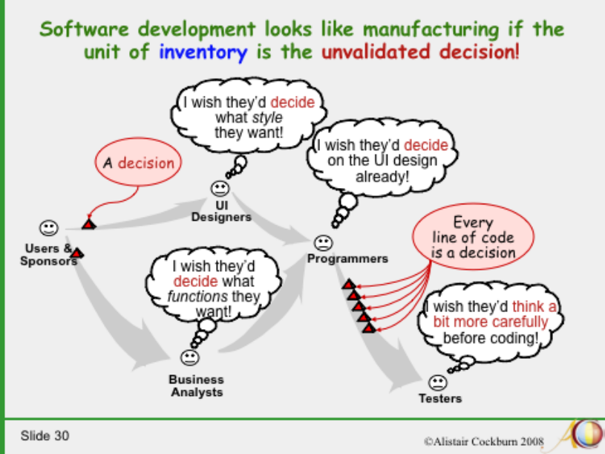
Cockburn’s Software Engineering in the 21st Century: http://alistair.cockburn.us/Software+engineering+in+the+21st+century.ppt
Cockburn’s Software Engineering in the 21st Century:
http://alistair.cockburn.us/Software+engineering+in+the+21st+century.ppt

Slide 20
